Slide 1
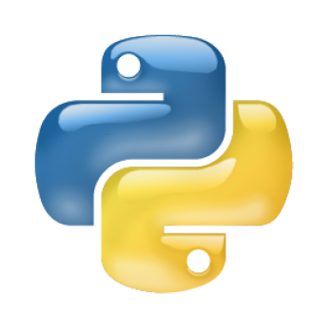
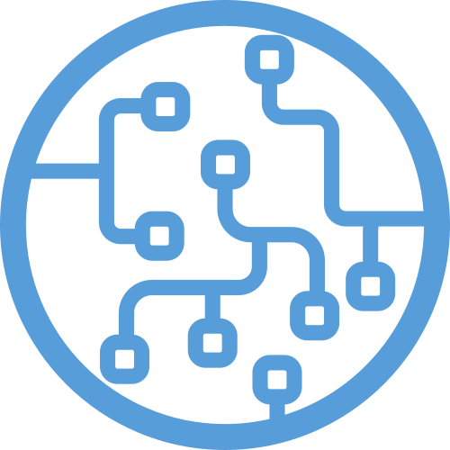
Frameworks para
Machine Learning
Prof. Dr. Diego Bruno
Education Tech Lead na DIO Doutor em Robótica e Machine Learning pelo ICMC-USP

Slide 2

Frameworks para
Machine Learning
Prof. Dr. Diego Bruno
Machine Learning

Slide 3
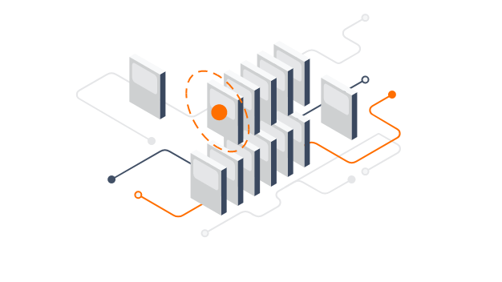
TensorFlow

Slide 4

TensorFlow
Parte 1: Introdução ao TensorFlow https://colab.research.google.com/drive/1F_EWVKa8rbMXi3_fG0w7AtcscFq7Hi7B#forceEdit=true&sandboxMode=true
Parte 2: Modelos de treinamento
https://colab.research.google.com/drive/15Cyy2H7nT40sGR7TBN5wBvgTd57mVKay#forceEdit=true&sandboxMode=true
Parte 3: Redes Neurais
https://colab.research.google.com/drive/1m2cg3D1x3j5vrFc-Cu0gMvc48gWyCOuG#forceEdit=true&sandboxMode=true
Parte 4: Visão Computacional
https://colab.research.google.com/drive/1ZZXnCjFEOkp_KdNcNabd14yok0BAIuwS#forceEdit=true&sandboxMode=true
Notes:
https://www.youtube.com/watch?v=tPYj3fFJGjk

Slide 5
Obrigado!
Machine Learning
Prof. Dr. Diego Bruno

